Slide 1
More Review Questions

Slide 2


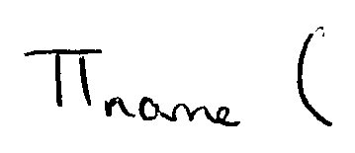
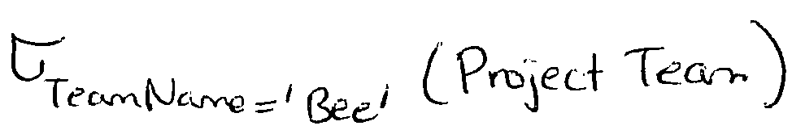
RA Review
Student (ID, Name, Deparment)
ProjectTeam(TeamName,ID)
Midterm(ID, Grade)

Slide 3
RA Review
Student (ID, Name, Deparment)
ProjectTeam(TeamName,ID)
Midterm(ID, Grade)

Slide 4
RA Review
Student (ID, Name, Deparment)
ProjectTeam(TeamName,ID)
Midterm(ID, Grade)

Slide 5
SQL Review

Slide 6
SQL Review
SELECT C.cname
FROM Customer C, Buy B, Book K
WHERE C.cid = B.cid AND K.isbn = B.isbn
AND C.city = ‘Ankara’ AND B.year = 2010
GROUP BY C.cid, C.cname
HAVING SUM(price) > 500

Slide 7
SQL Review
SELECT B1.cid, B2.cid
FROM Buy B1, Buy B2
WHERE B1.isbn = B2.isbn AND B1.cid <> B2.cid
B1.cid < B2.cid

Slide 8
SQL Review
SELECT C.cid
FROM Customers C
WHERE NOT EXISTS (
(SELECT Publisher FROM Book)
EXCEPT
(SELECT Publisher
FROM Book K, Buy B
WHERE K.isbn = B.isbn AND B.cid = C.cid) )

Slide 9
SQL Review
SELECT B2.cid
FROM Buy B1, Buy B2
WHERE B1.cid = 1234 AND B1.isbn = B2.isbn AND B1.cid <> B2.cid
GROUP BY B2.cid
HAVING COUNT(*) > 20

Slide 10
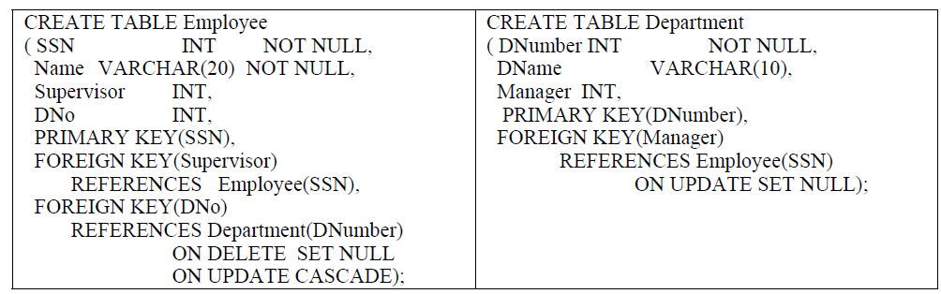
SSN | Name | Supervisor | DNo
12 | Can | NULL | NULL
15 | Oya | 12 | 2
14 | Oya | 12 | 5
DNumber | DName | Manager
2 | Eng | 12
5 | Admin | 15
REJECTED: PK constraint
REJECTED: NOT NULL constraint

Slide 11
SSN | Name | Supervisor | DNo
12 | Can | NULL | NULL
NULL
15 | Oya | 12 | 2
18
14 | Oya | 12 | 5
6
DNumber | DName | Manager
2 | Eng | 12
DNumber | DName | Manager
5 | Admin | 15
6
NULL
REJECTED: ON DELETE NO ACTION for Supervisor field

